Slide 1
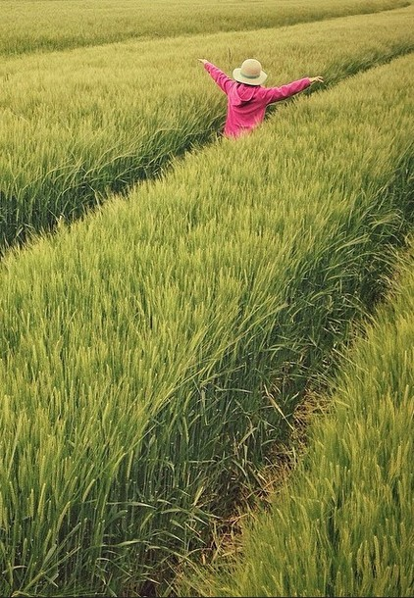
AGRICULTURE PRODUCTION OPTIMZATION ENGINE
PROJECT BY: -
DEVAM ZANZMERA - 18BCP022 DEV TAILOR - 18BCP018

Slide 2


TABLE OF CONTENTS
SR NO
TITLE
1
2
ABSTRACT INTRODUCTION
3
RELATED WORK
4
PROPOSE SYSTEM
5
MODEL EVOLUTION
6
CONCLUSION

Slide 3

ABSTRACT
Agriculture and crop production plays an important role in country’s economy. Especially, In India farming is considered as the primary occupation. The main aim of this study is to make prediction of most suitable crops using various machine learning algorithms. We have compared various machine learning algorithms like Logistic Regression (LR), Random Forest (RF), Decision Tree (DT), Support Vector Machine (SVM), Naïve Bayes (NB) and Extreme Gradient Boosting (XG Boost). All these algorithms are applied on the Crop dataset that contains Different types of crops, Temperature, Humidity, PH value, Rainfall, Nitrogen, Phosphorous, and Potassium. Performance of above- mentioned algorithms is tested using given dataset in terms of high accuracy and error rate of the model. Also, different types of simulators and attributes based on the given dataset are used for predicting the most suitable crops. After analysis of all algorithms, Random Forest is found more accurate and most recommended for the prediction of crops and for profitable agriculture for the farmers.

Slide 4
RELATED WORK
AgroConsultant:
Efficient Crop Yield
Crop
Intelligent Crop
Recommendation
recommendation
Recommendation
system to maximize
System Using
crop yield in ramtek
System Using Machine
Machine Learning for
region using
Learning Algorithms.
Digital Farming.
machine learning.

Slide 5
PROPOSED SYSTEM
1
2.
3.
4.
5.
Datasets Collection
Noise Removal (Pre- Processing)
Exploratory Data Analysis
Algorithms For Prediction
Recommended Crop & Algorithms

Slide 6

DATASET COLLECTION
Taken from kaggle. size is 2200*8.
attributes like Nitrogen, Potassium, Phosphorous, Rainfall, PH value, Temperature, Humidity, Crops name.

Slide 7
Noise Removal (Pre - Processing)
finding missing value from the table. calculating avg value of the column. adding that avg value to missing block.

Slide 8
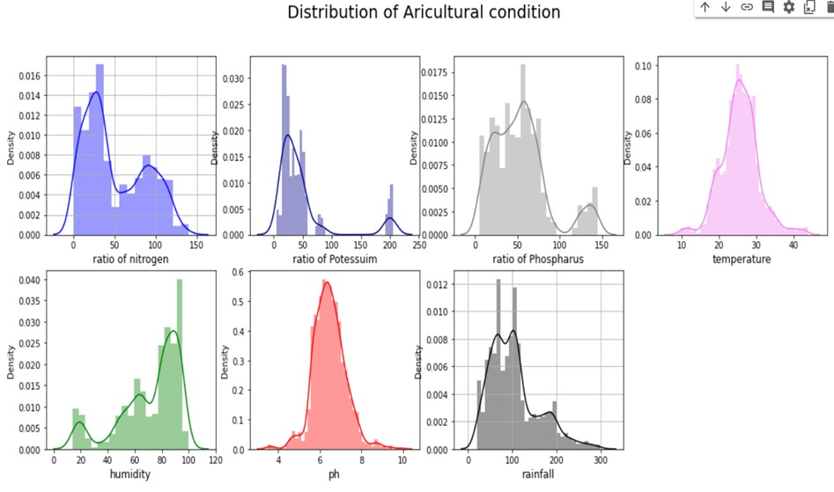
Exploratory Data Analysis
For visualization, we use distplot function from seaborn library for each attribute.

Slide 9
Implementing Algorithms.
Logistic Regression. Decision Tree.
Random Forest.
Support Vector Machine. Naive Bayes.
Extreme Gradient Boosting (XG Boost).

Slide 10
Model Evaluation
We have taken 2 factors to considerate to analyze the fitting of the models which are Accuracy and Execution time.
For find accuracy, we use Classification Report library.

Slide 11
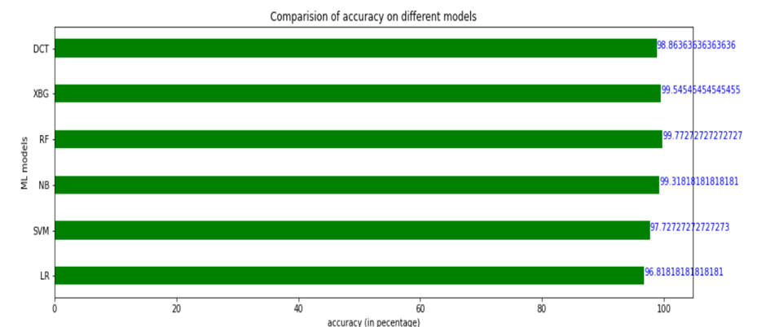
Algorithms VS Accurcy Chart

Slide 12
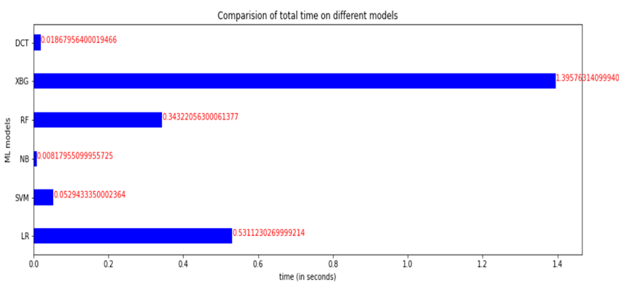
Algorithms VS Execution Time Chart.

Slide 13
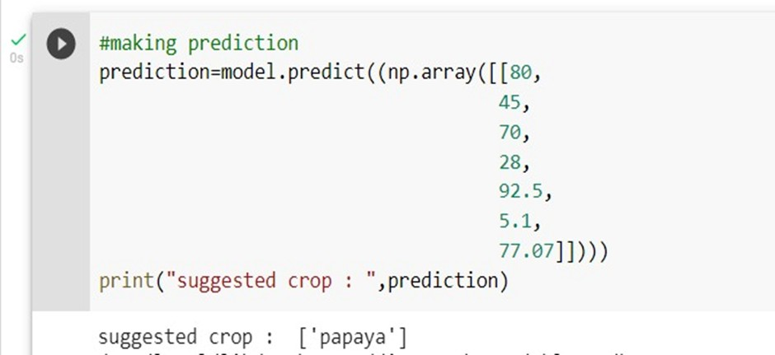
Crop Prediction

Slide 14
Conclusion
We did analysis on these six types of machine learning algorithms.
Random Forest achieved best accuracy result. Gaussian NB achieved best execution time.

Slide 15






